Slide 1
Microwave Devices E511
Lecture 4
Amr Al.Awamry

Slide 2
Agenda
Stripline
Microstrip line

Slide 3
Strip Lines
Strip line types can be : symmetric and asymmetric
Which mode expected to be in strip line ??

Slide 4
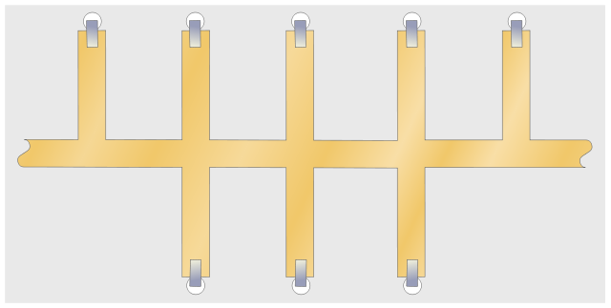
Striplines Cont.
Kindly look at attenuation formula …. Same concept don’t worry ;)

Slide 5
Microstrip

Slide 6
Microstrip … cont.

